Slide 1

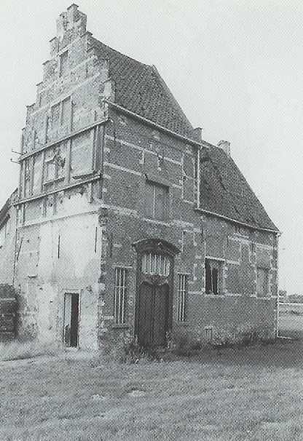




40min
Event Sourcing CQRS
Theoretical
Introduction
ArchitectureTrack

Slide 2




Menu
EventSourcing
CQRS

Slide 3

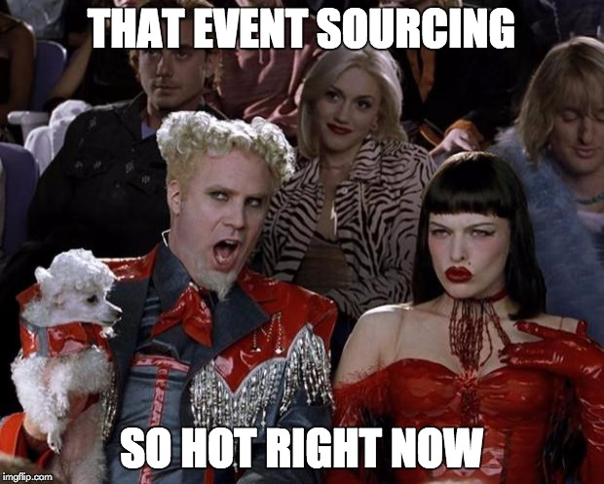

Slide 4


Event Sourcing
An Event-driven architecture where the current application state is calculated by handling an ordered sequence of events

Slide 5
Event Sourcing
An Event-driven architecture
Storing Events vs Application State
The Event Store: a very complete Audit Log
Events should be Domain Events
Events should be reversible
You’ll have to teach each dev the “right way”
Notes:
Save Events as JSON, XML or whatever.
In whatever you want: FileSystem, Database, …
Typically: EventName (className), Version, TimeStamp, Sequence & Data
Event Store:
https://github.com/EventStore/EventStore
Domain Events:
Insert, Update, Edit, Delete xxx Events are not Domain Events
Reversible Events:
Contain the diff instead of the new value
Or also contain a copy of the previous state

Slide 6
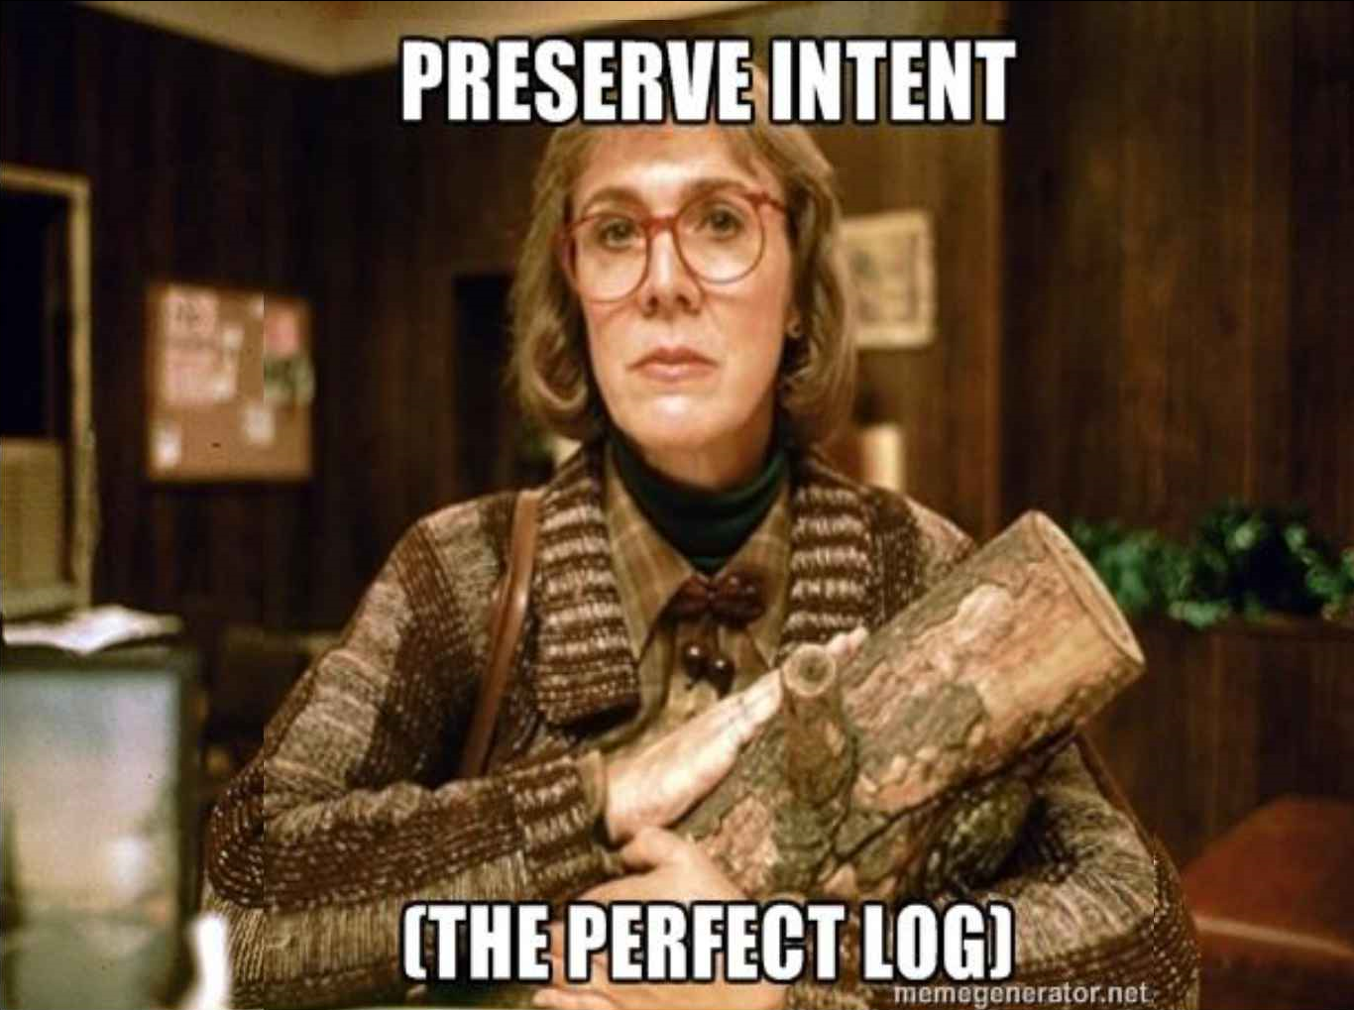
Event Sourcing

Slide 7




Features
Complete Rebuild
Temporal Queries
Event Replay
Projections
Rewriting History
Debugging

Slide 8
Feature: Complete Rebuild
Replaying a lot of events -- that’s gonna take time!
Rehydration
Do Store the Application State
In memory
In a database
Create snapshots

Slide 9
Feature: Temporal Queries
function getAddress(at: Date)
Notes:
With a database: You can only get the current state
With event-sourcing:
What was the state at any time
How did we get to our current state

Slide 10
Feature: Projections
Application State
Human Readable Audit Log
BI & Reporting
ElasticSearch

Slide 11
Feature: Rewriting History
Correct Errors
Domain Rule Changes
Merge Events
Multiple Timelines

Slide 12
When
When your domain requires one or more of those features!
NOT Your Typical CRUD Enterprise Application
Complex Domain & Many Business Rules
Rules that change over time
Task Based UI

Slide 13
When: Linearization
You want a global ordering of events
For the 10% of apps where this is not the case, there is extra complexity
Causal Consistency
Conflict Detection
Notes:
You want global ordering: because it makes things much easier.
Causally related events are executed in a “happens-before relationship”.
MongoDB has this.

Slide 14
When No Linearization
Very (very) high throughput
Favor availability over consistency
Occasionally connected servers
Clients with bad wifi, tunnels, …

Slide 15


Examples
Version Control System
Finance & Accounting
Gambling & Lotteries
Redux
Barema Wage Calculation

Slide 16


Implementation
Transaction Script
class PublishEvent {
String JointCommittee;
Date PublishDate;
}
class PublishHandler : Handler<PublishEvent>
Notes:
The alternative is to work with a Domain Model.

Slide 17
Implementation
Event Handler Selection
Inside the event itself
Reflection
Configuration Files
Naming Convention
A Library
Process Manager

Slide 18
Implementation
Process Manager
The flow as a first class citizen
Manage process state
Routing slip
A State Machine
Notes:
Process Manager:
Once several subsystems start handling events, the system becomes hard to visualize / conceptualize.
The source code no longer tells you how the application reacts to user actions.
Instead you can use a Process Manager to delegate (Event -> Command(s))

Slide 19



Challenges
Event Versioning
Backwards Compatible Please
Rewrite History
EventV2
Notes:
Protobuf: Built with this in mind

Slide 20
Challenges
External Systems
A Gateway
Mock during Replay
Store original reply

Slide 21
CQRS
Command Query Responsibility Segregation
Did you mean CARS?
Notes:
https://martinfowler.com/bliki/CQRS.html

Slide 22
CQS
Command-Query Separation
Each method is either a
Command: perform an action
Query: return data to the user
Notes:
1988, Betrand Meyer, Object Oriented Software Construction.

Slide 23
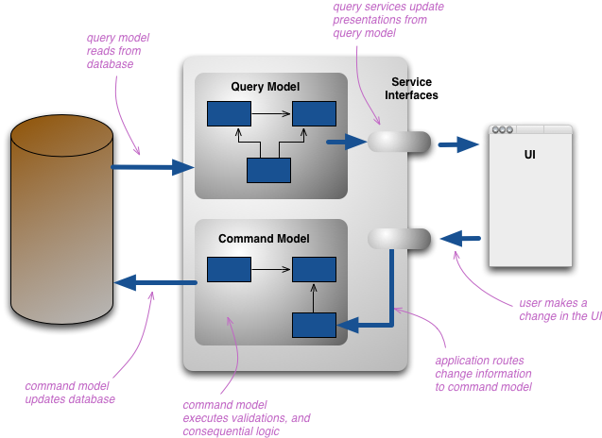
CQRS

Slide 24
CQRS - What
Read & Write Models
Read & Write Databases
Complexity Booster
Eventual Consistency

Slide 25
CQRS - When
Complex BL & DDD
Non CRUD
Specific Portions of the app (BoundedContext)

Slide 26
CQRS - Danger
Despite these benefits, you should be very cautious about using CQRS… … while CQRS is a pattern that’s good to have in the toolbox, beware that it is difficult to use well. -- Martin Fowler
Notes:
The part in bold is the ONLY part in Fowler’s article that is in bold.

Slide 27
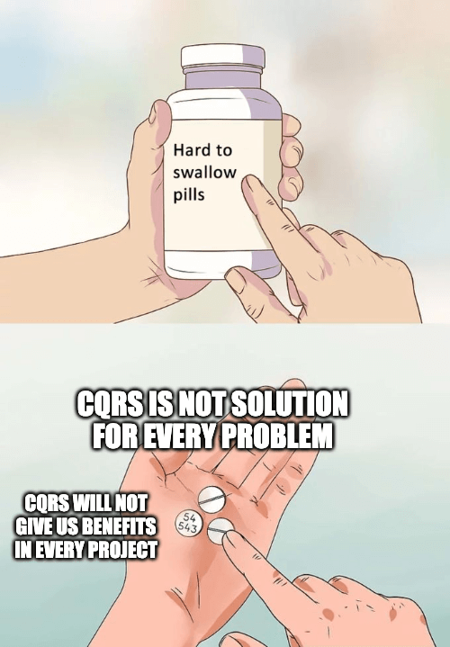
Common Anti-Patterns
(from Greg Young)
Not top-level architectures
Not top-level architectures
Pick & Choose those parts that will benefit from it
Notes:
Not top-level architectures:
https://itenium.be/blog/design/CQRS-Ramble/

Slide 28
Common Anti-Patterns
(from Greg Young)
The Write Side Queries The Read Side
Be Pragmatic!
Don’t use Frameworks
Functions
Pattern Matching
Fold

Slide 29

Use Case
Herberekening uitbetaalde
pensioenen parlementsleden?
Piece of cake with Event-Sourcing! 😃

Slide 30
Barema’s
A certain set of rules apply per CAO publish
Publishes are Snapshots
Events are divided per JointCommittee
Mistakes will occur
We need to go back in time,
Adjust, insert or delete events
History will be rewritten
Notes:
JointCommittee==Paritair Comité. 200 for us.

Slide 31


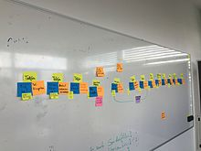
Event Storming
Business Process Modeling
Requirements engineering
Maybe a future soft-skill workshop session?
Notes:
Alberto Brandolini in the context of domain-driven design (DDD)

Slide 32
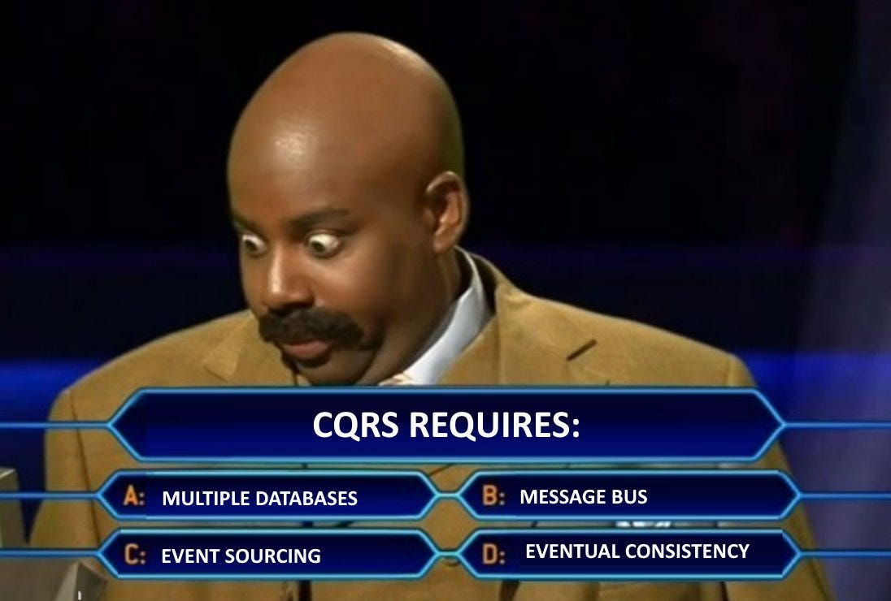
Quiz

Slide 33



THANK YOU!

Slide 34
WiFi: itenium-guest / Wifi4Ufree

